Slide 1
Criminal Justice
By: Shannon Miller
Notes:
Source: https://www.papermasters.com/criminal-justice-process.html

Slide 2
WHAT I WILL BE COVERING…
Defiinition of Criminal justice
The Process of Criminal Justice if the crime were a misdemeanor
1.)Arrest/Complaint
2.)Booking
3.)Advisement Hearing/ Mandatory Protection Order
4.)Pre-trial Conference Arrangement
5.)Motions Hearing
6.)Trial by Jury or Court
7.)Verdict
8.)Not Guilty or Guilty?

Slide 3
WHAT IS CRIMINAL JUSTICE?
Set of agencies/processes established by governments to control crime and impose on those who violate laws

Slide 4
Arresting/booking
Police take suspect into custody
Following an arrest a booking occurs
(photographing and fingerprinting)
Creates an administrative record of a suspect

Slide 5
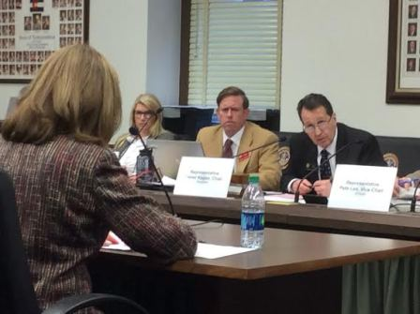
ADVISEMENT HEARING MANDATORY PROTECTION ORDER
Suspect appears before judge
Hears formal charges
May or may not post bail

Slide 6
Preliminary hearing or grand jury
Preliminary hearing = public
Grand Jury = private
To ensure that the innocent are not hastily being prosecuted

Slide 7
The Remainder of tHE PROCESS…
Involves trial, sentencing, corrections and release upon completion of a sentence

